Slide 1
EDA Case Study
Sushanth Kamath & Ashutosh Aman

Slide 2
Context on the assignment
Lending Club (LC) is the largest online marketplace facilitating a variety of retail loans.
Lending Club (LC) wants to identify patterns from past loan applicants and whether an applicant is likely to default.
The objectives of the case study are to :
Identify risky loan applicants to minimise credit loss
To understand how consumer attributes and loan attributes influence the tendency of default.
Identify variables that are possible causes for loan default
Provide recommendations on the attributes that could cause loan default

Slide 3
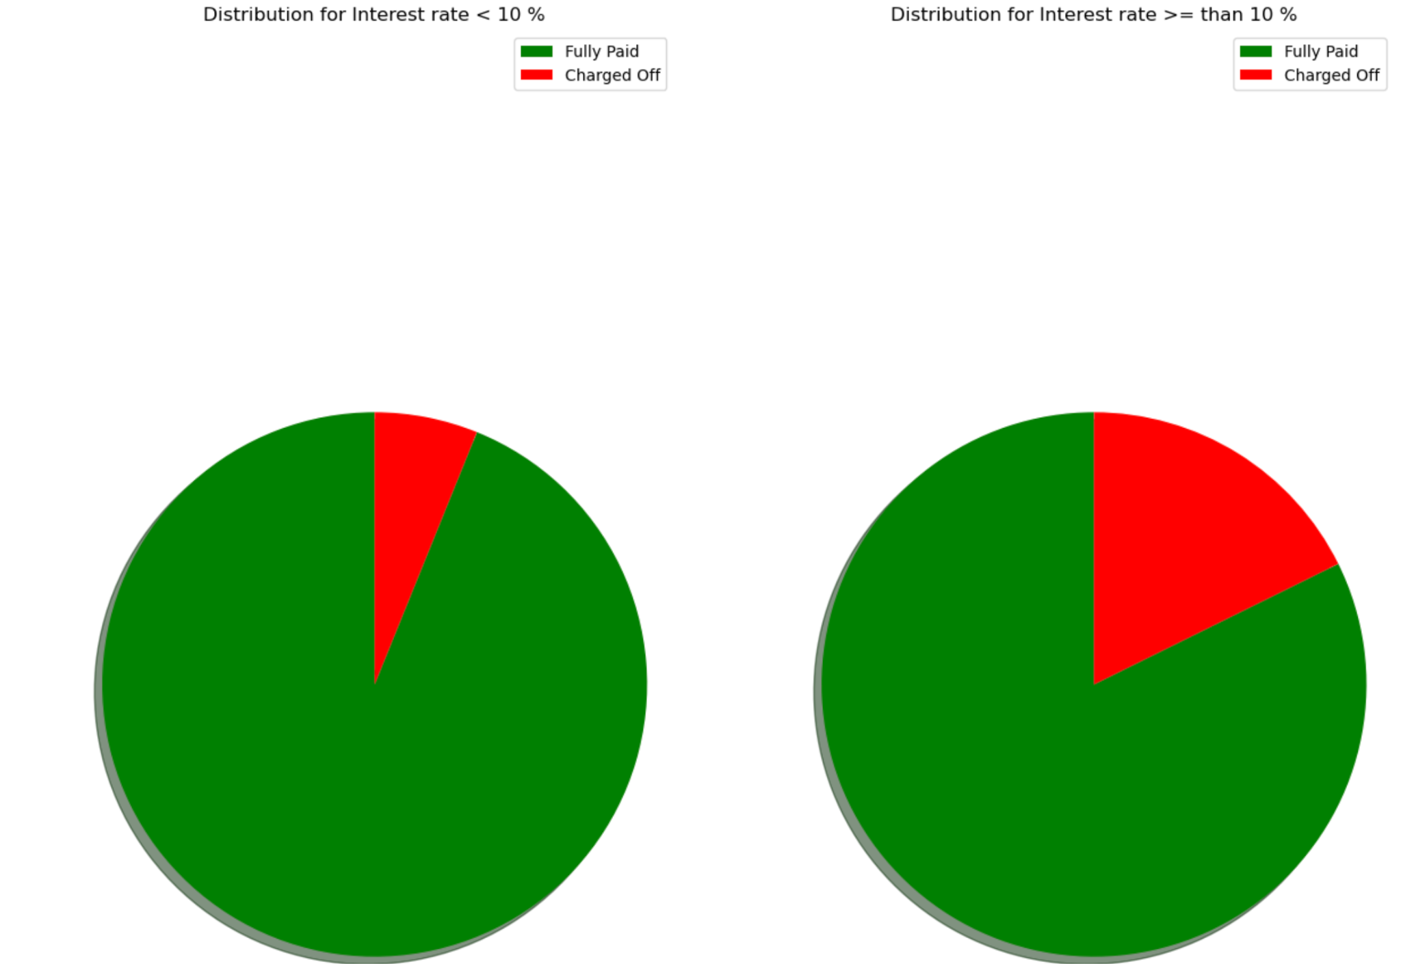
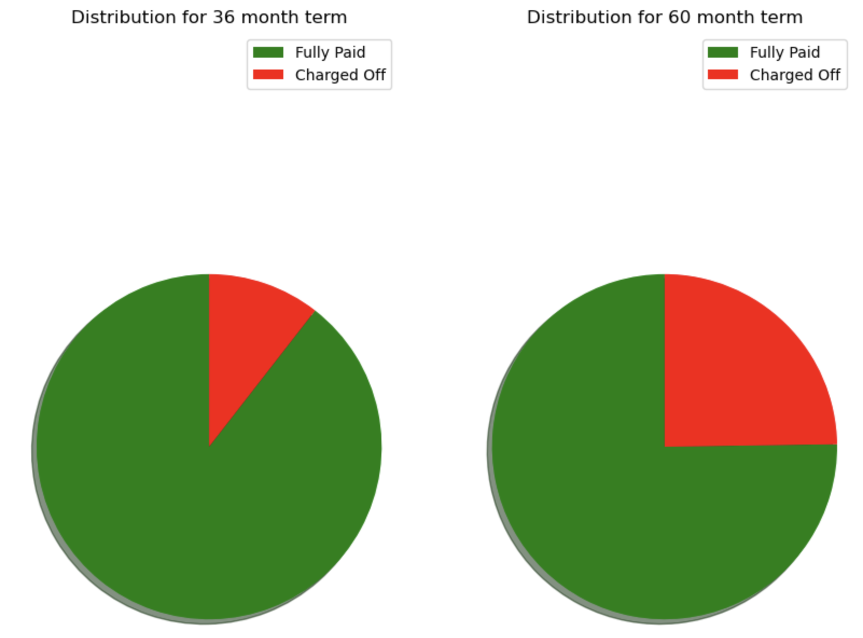
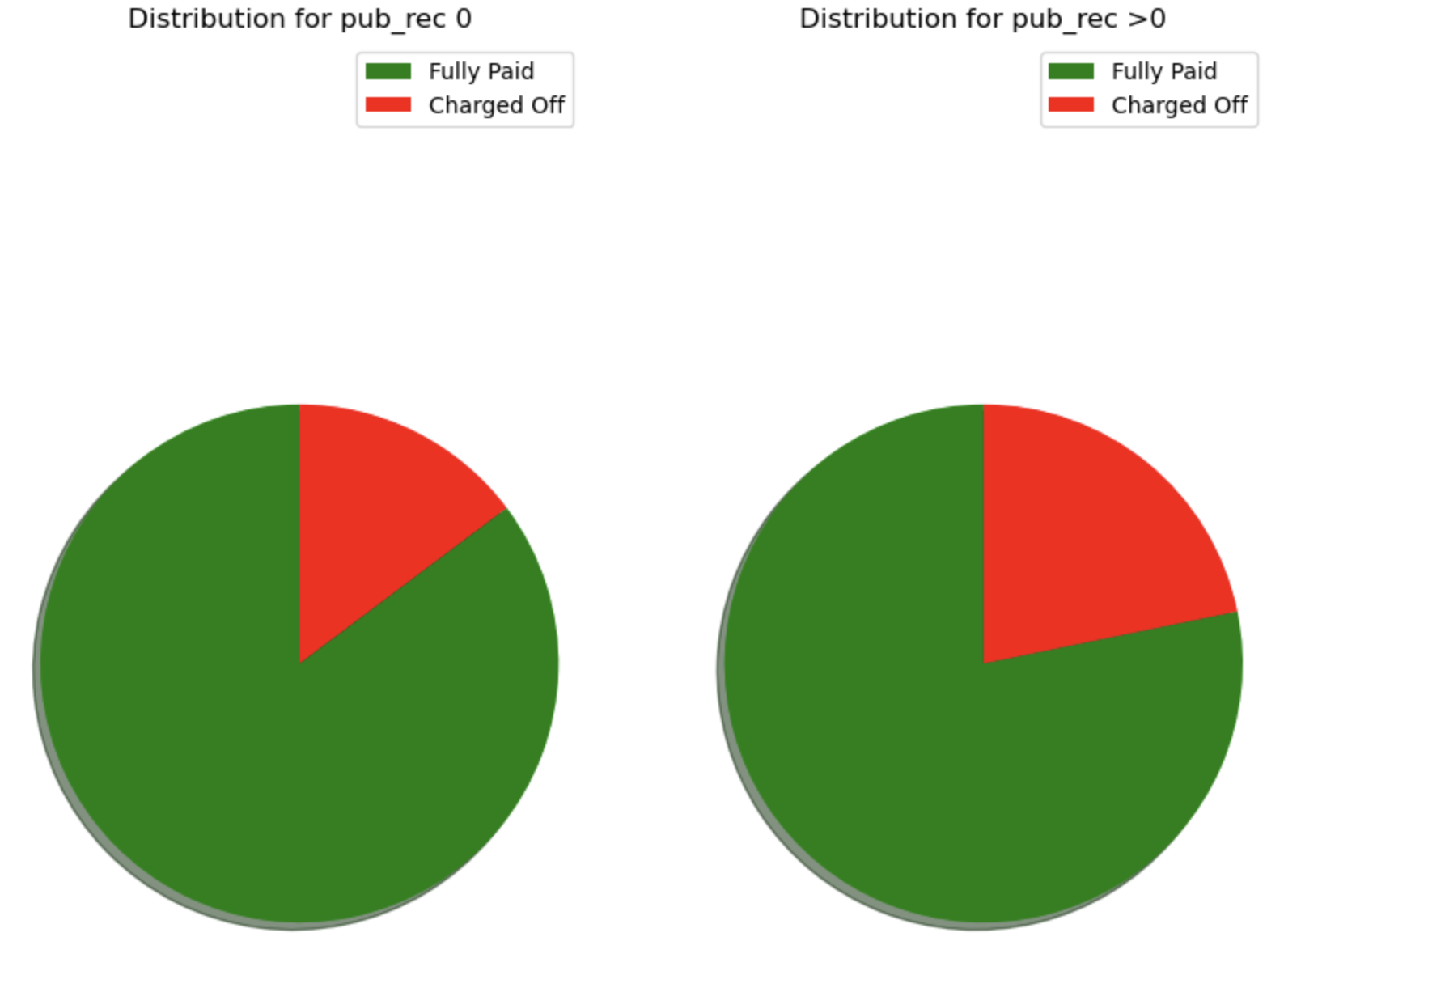
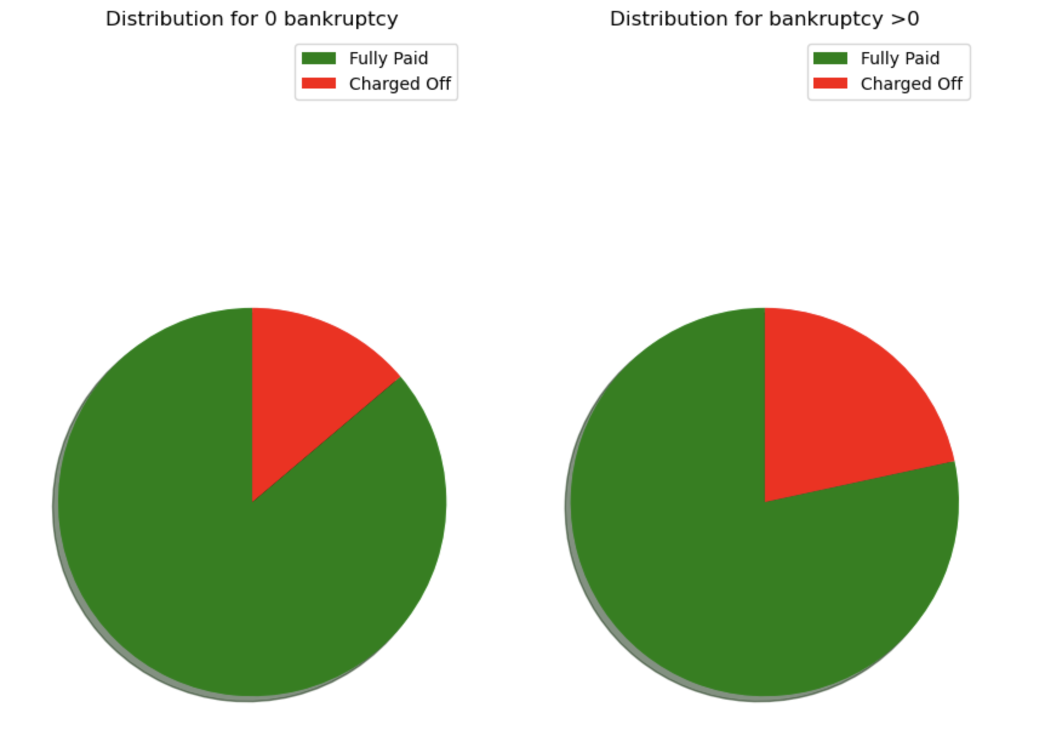
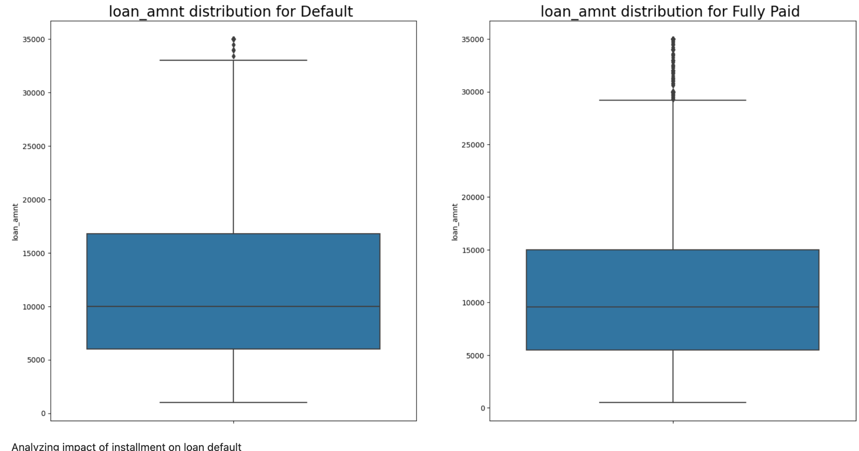
Univariate Analysis

Slide 4
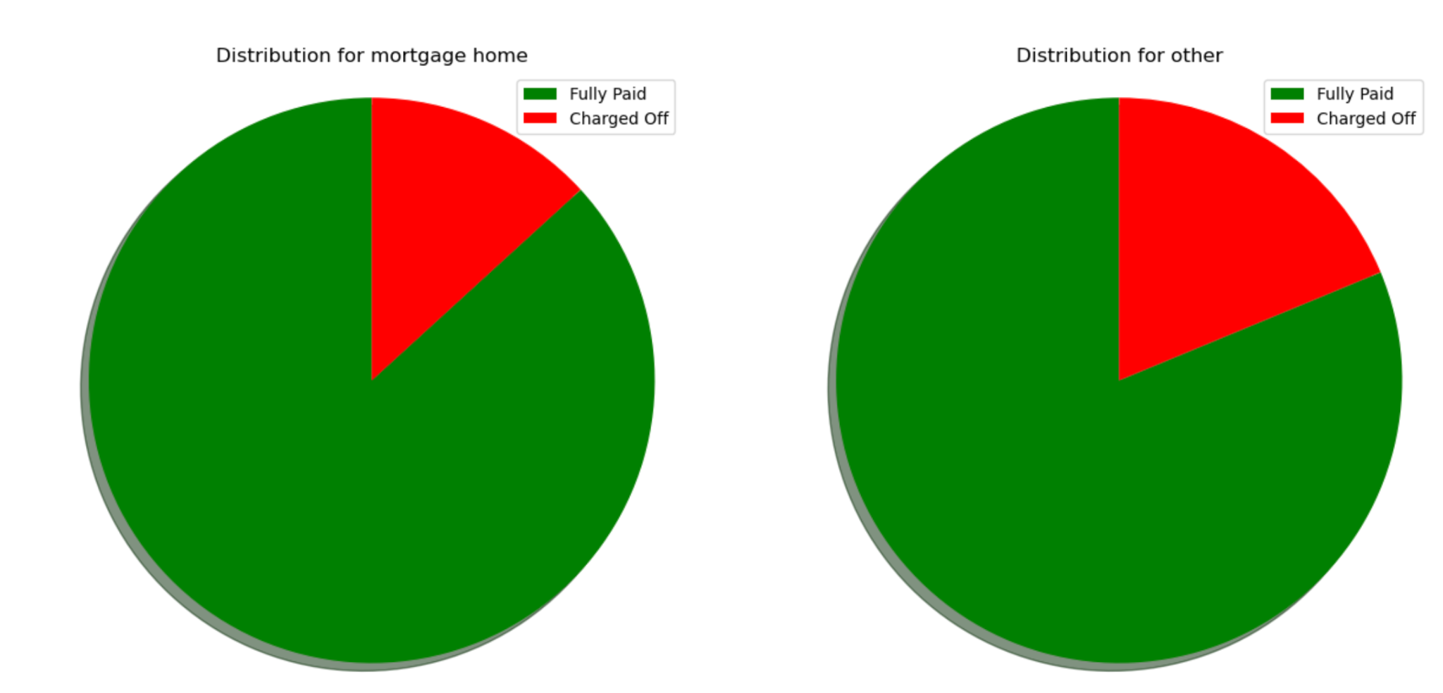
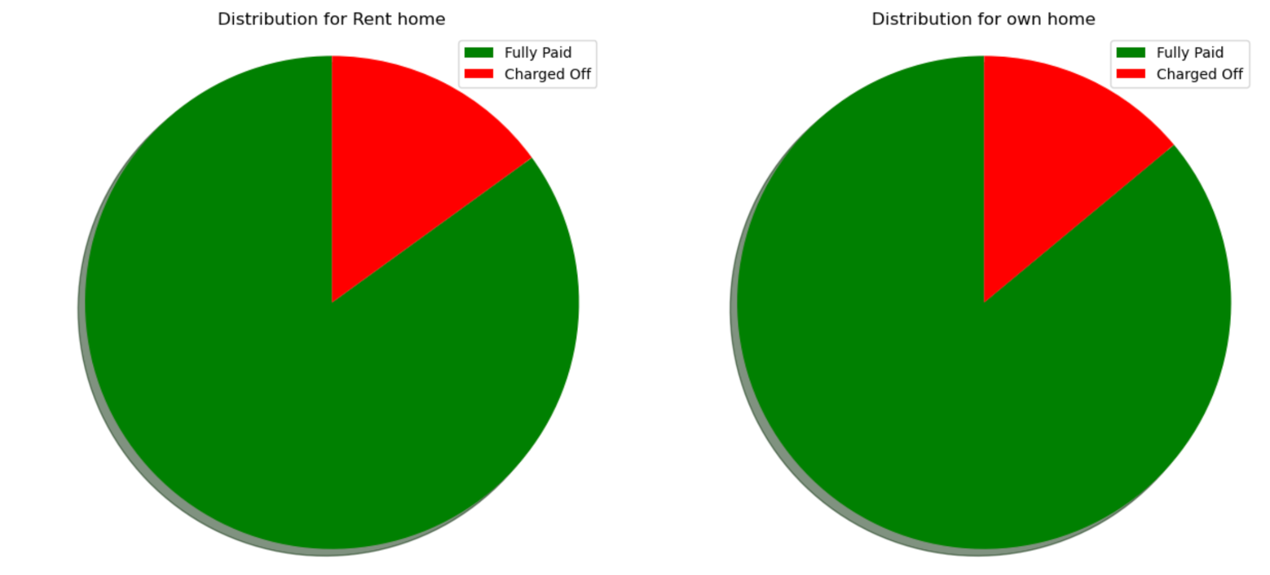
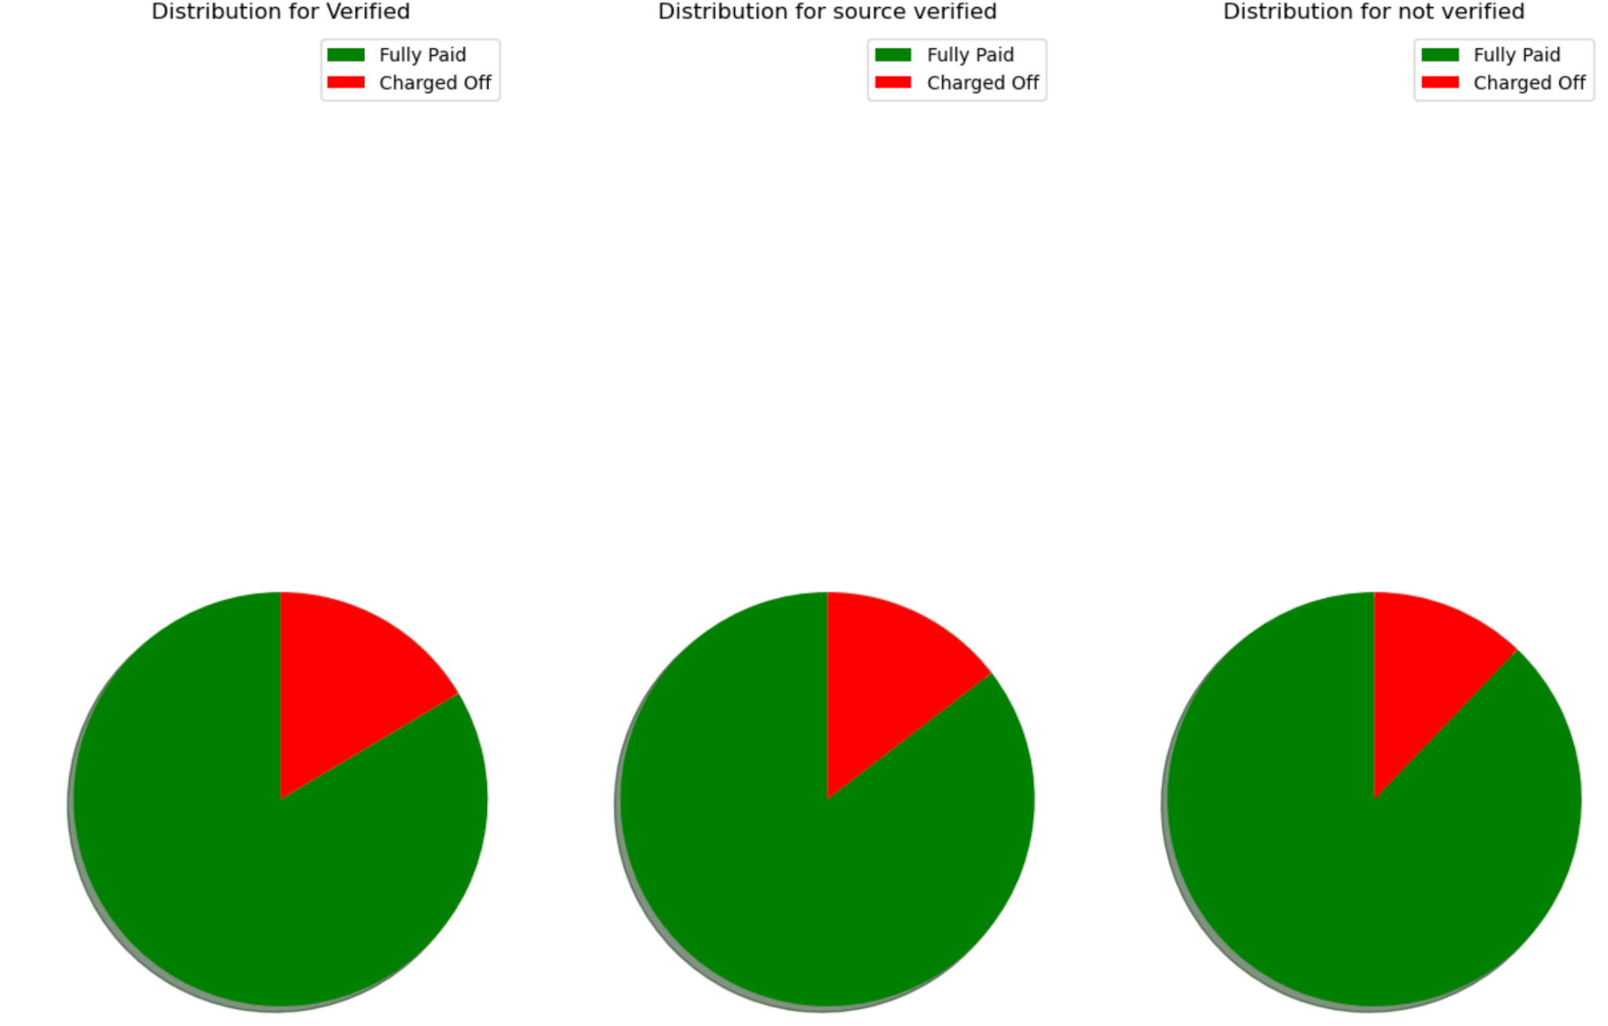

Slide 5
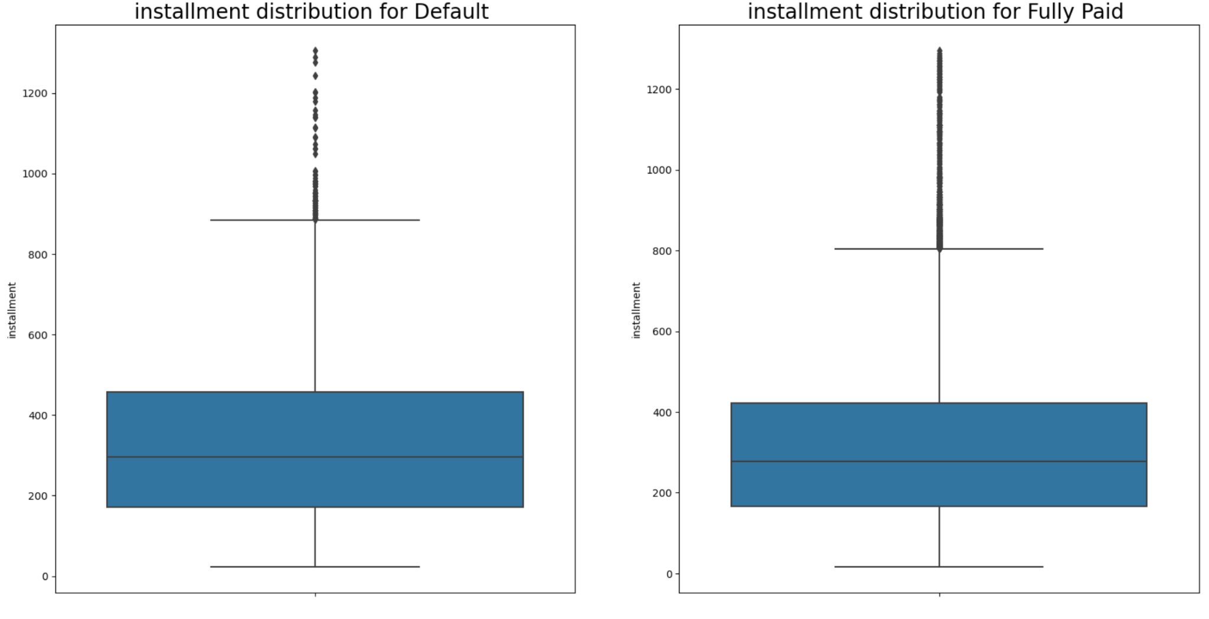
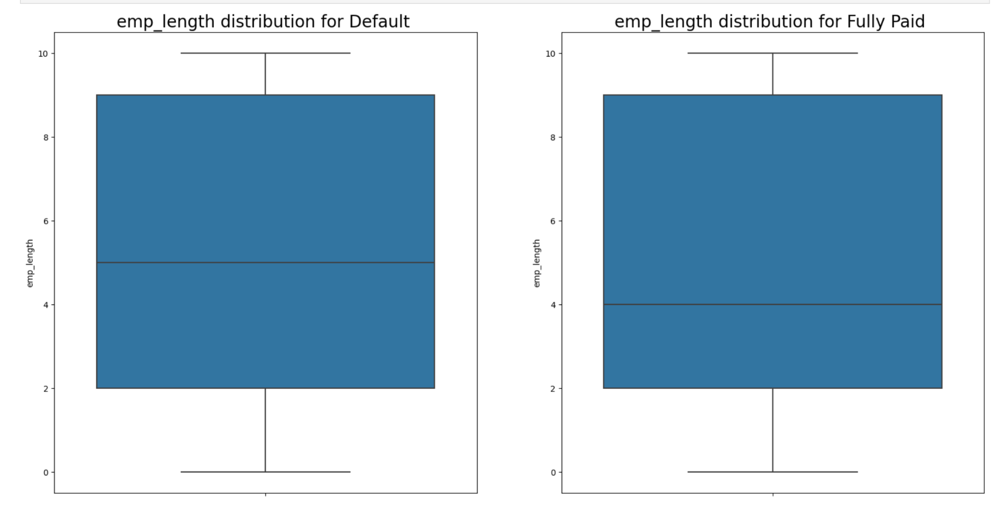
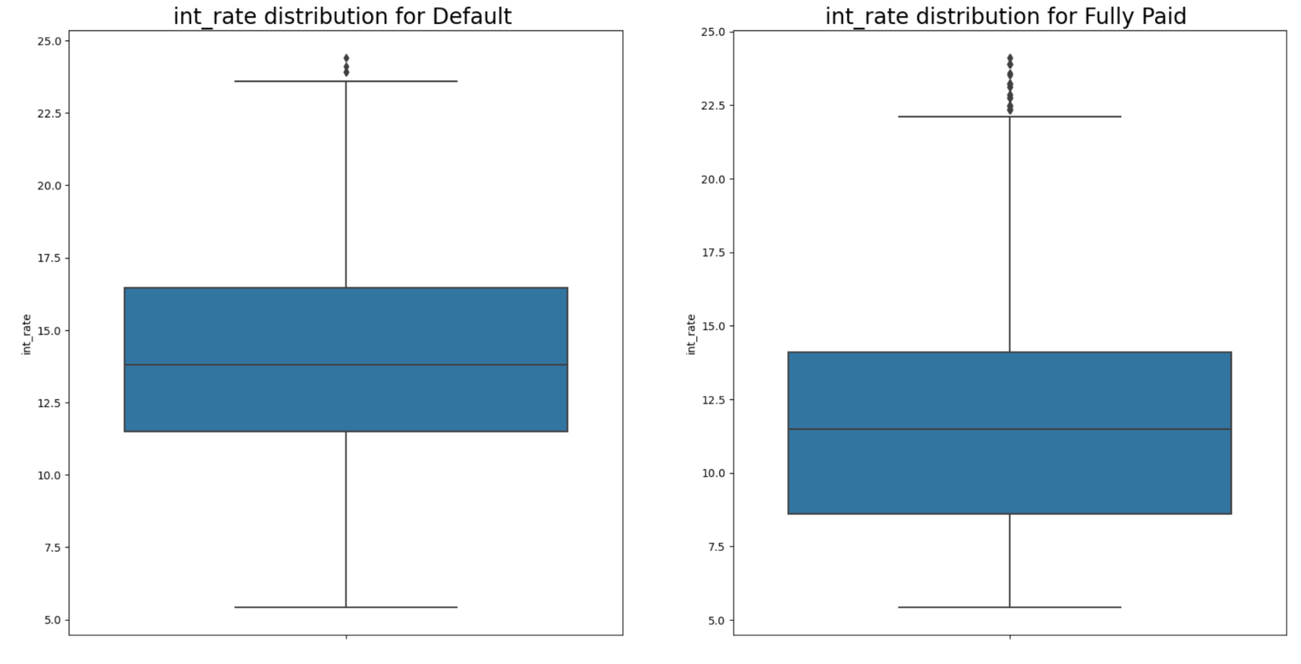

Slide 6
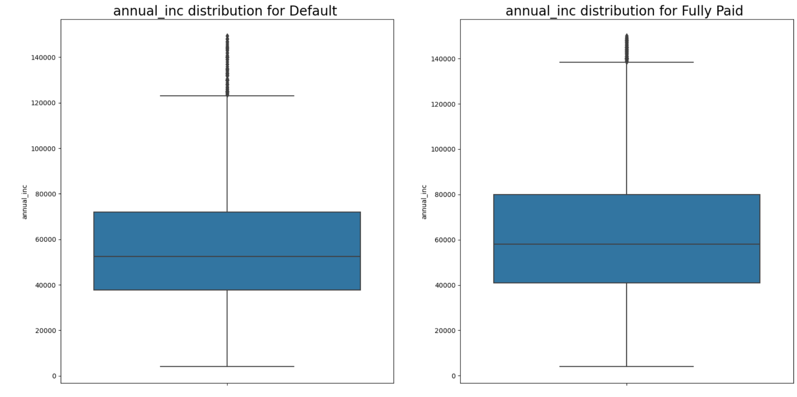

Slide 7
Univariate analysis - Inference
Field | Influences default ? | Inference
Loan tenure | Yes | Accounts with 60 month term have 15 percentage points higher probability of default
Annual Income | Yes | Accounts with income less than 100K have higher probability of default
Verification | No | No significant difference is observed between loan default and fully paid status based on whether the borrower's income source was verified or not
Employment length | No | No significant difference is observed between loan default and fully paid status based on the tenor of the employment of the loan borrowers
Interest Rate | Yes | Accounts with interest rate greater than 13% have higher probability of default
Bankruptcies record | Yes | Accounts with bankruptcy have 8 percentage points higher probability of default
Credit enquiries | Yes | Accounts with more than 1 occurrence have higher probability of default

Slide 8
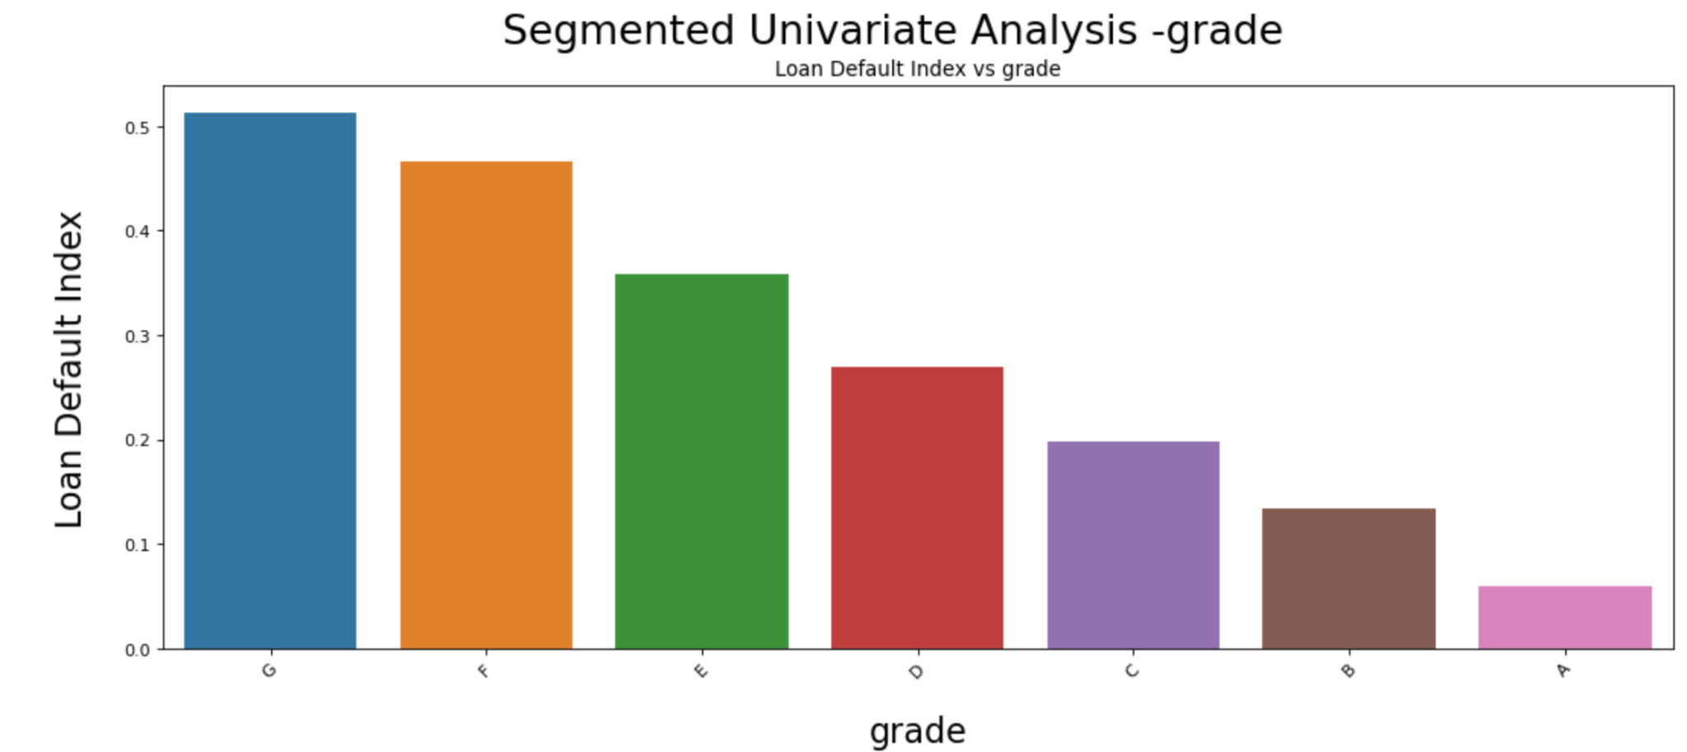
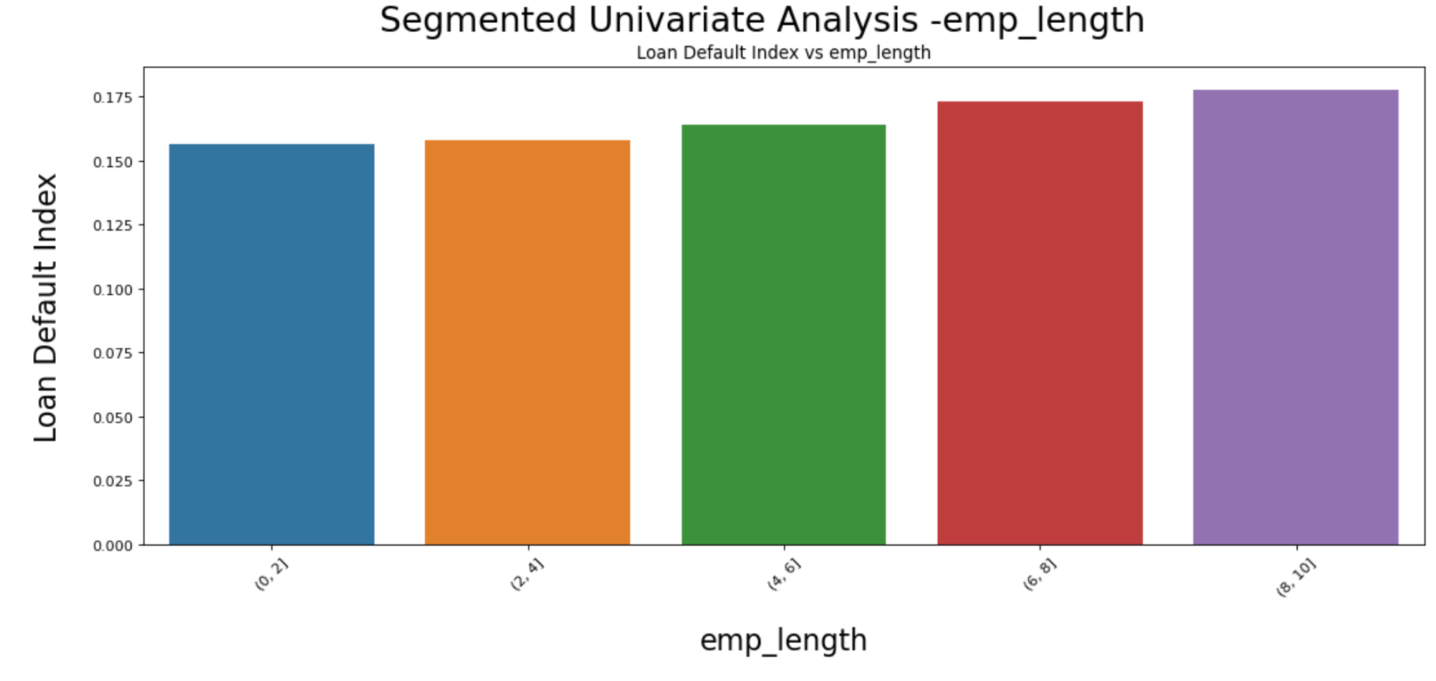
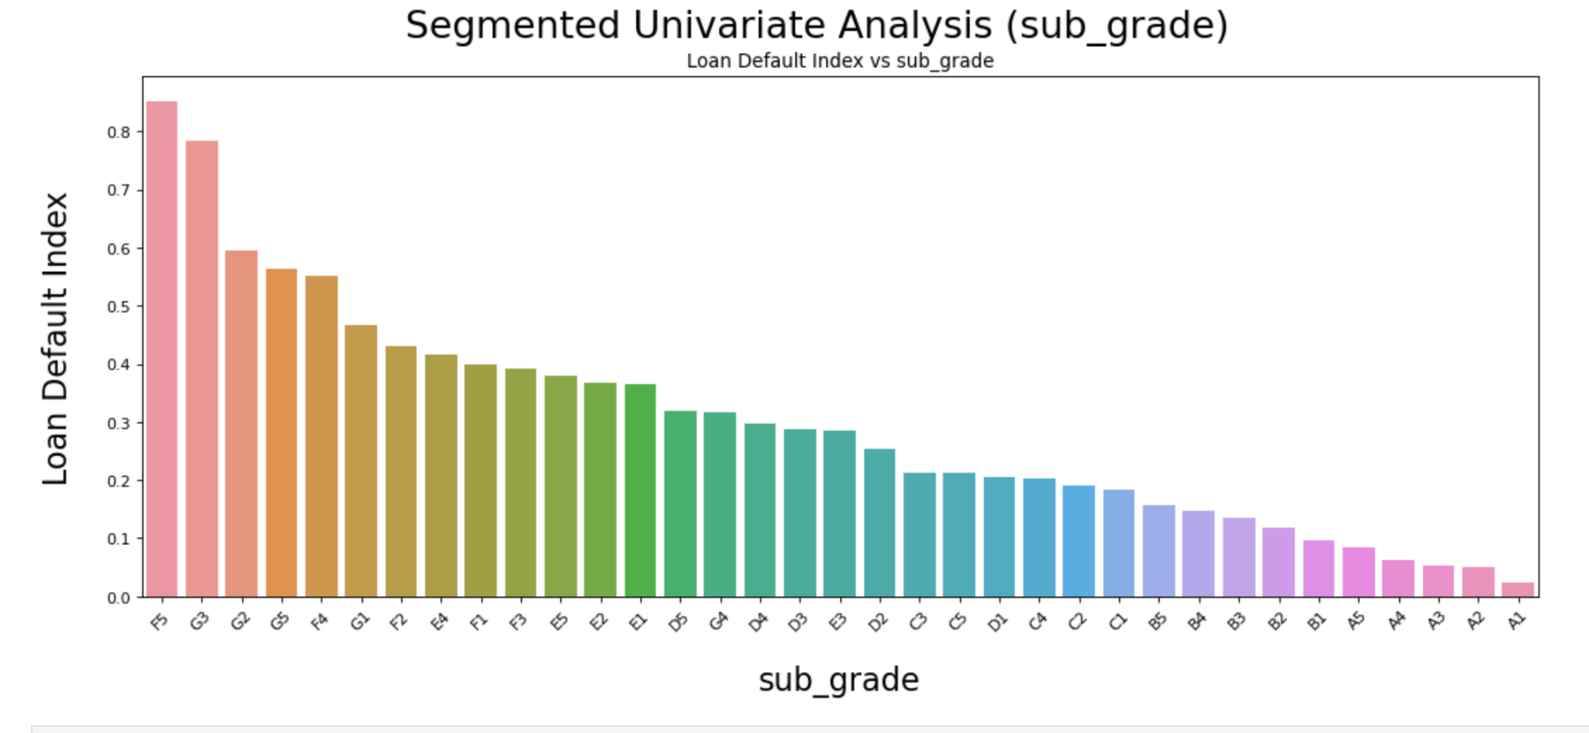
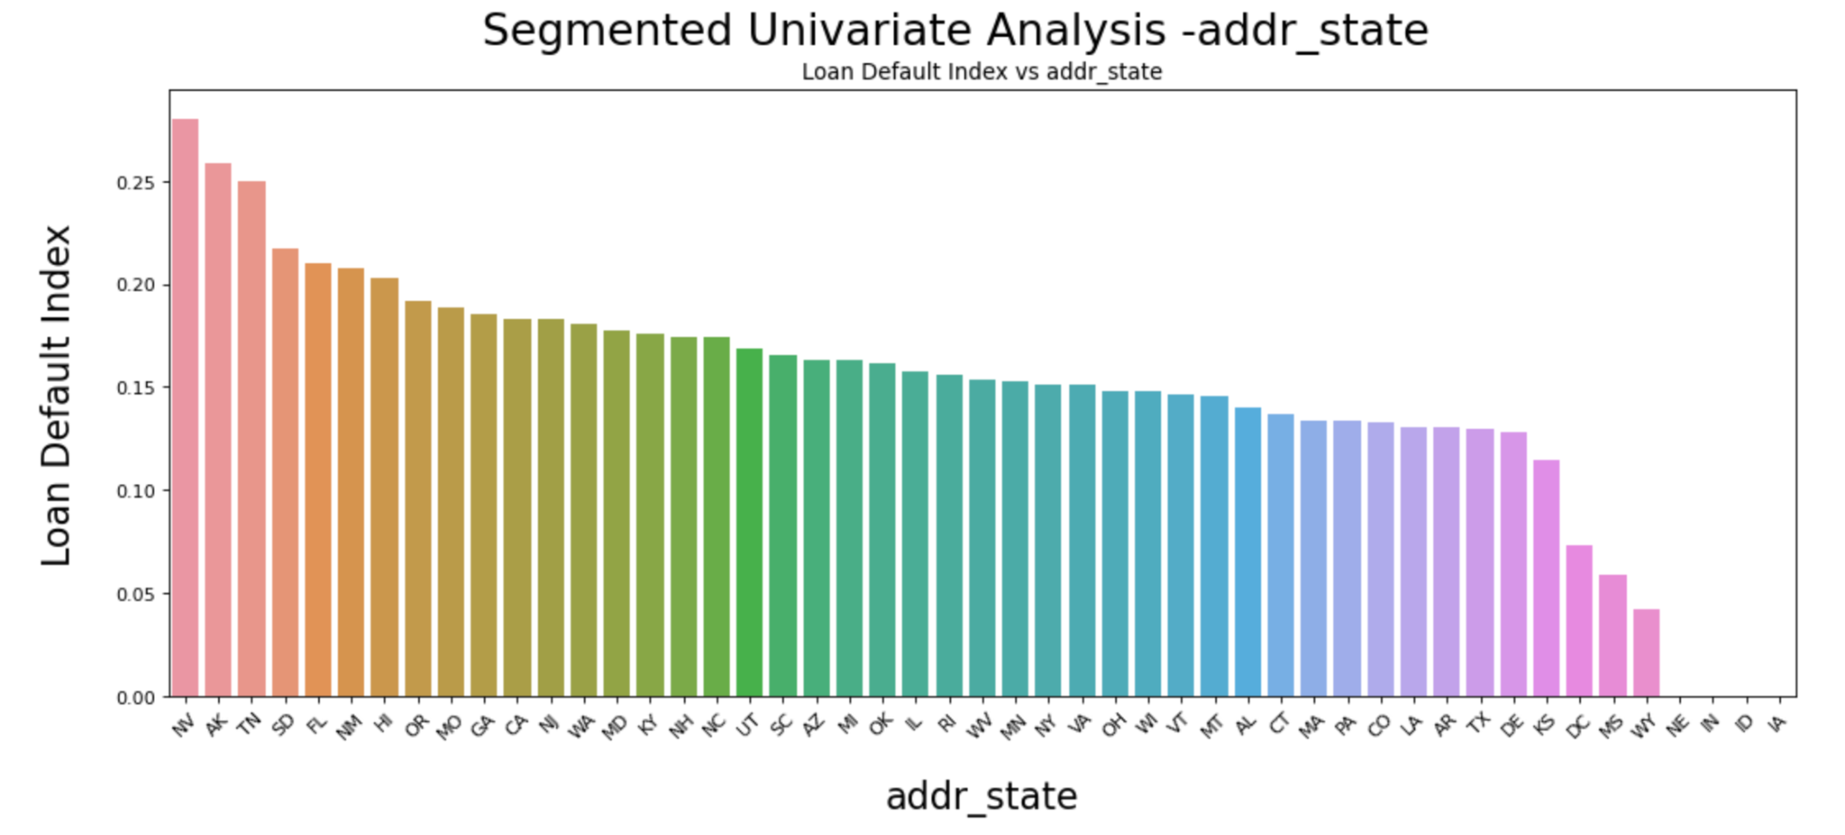
Segmented Univariate Analysis

Slide 9
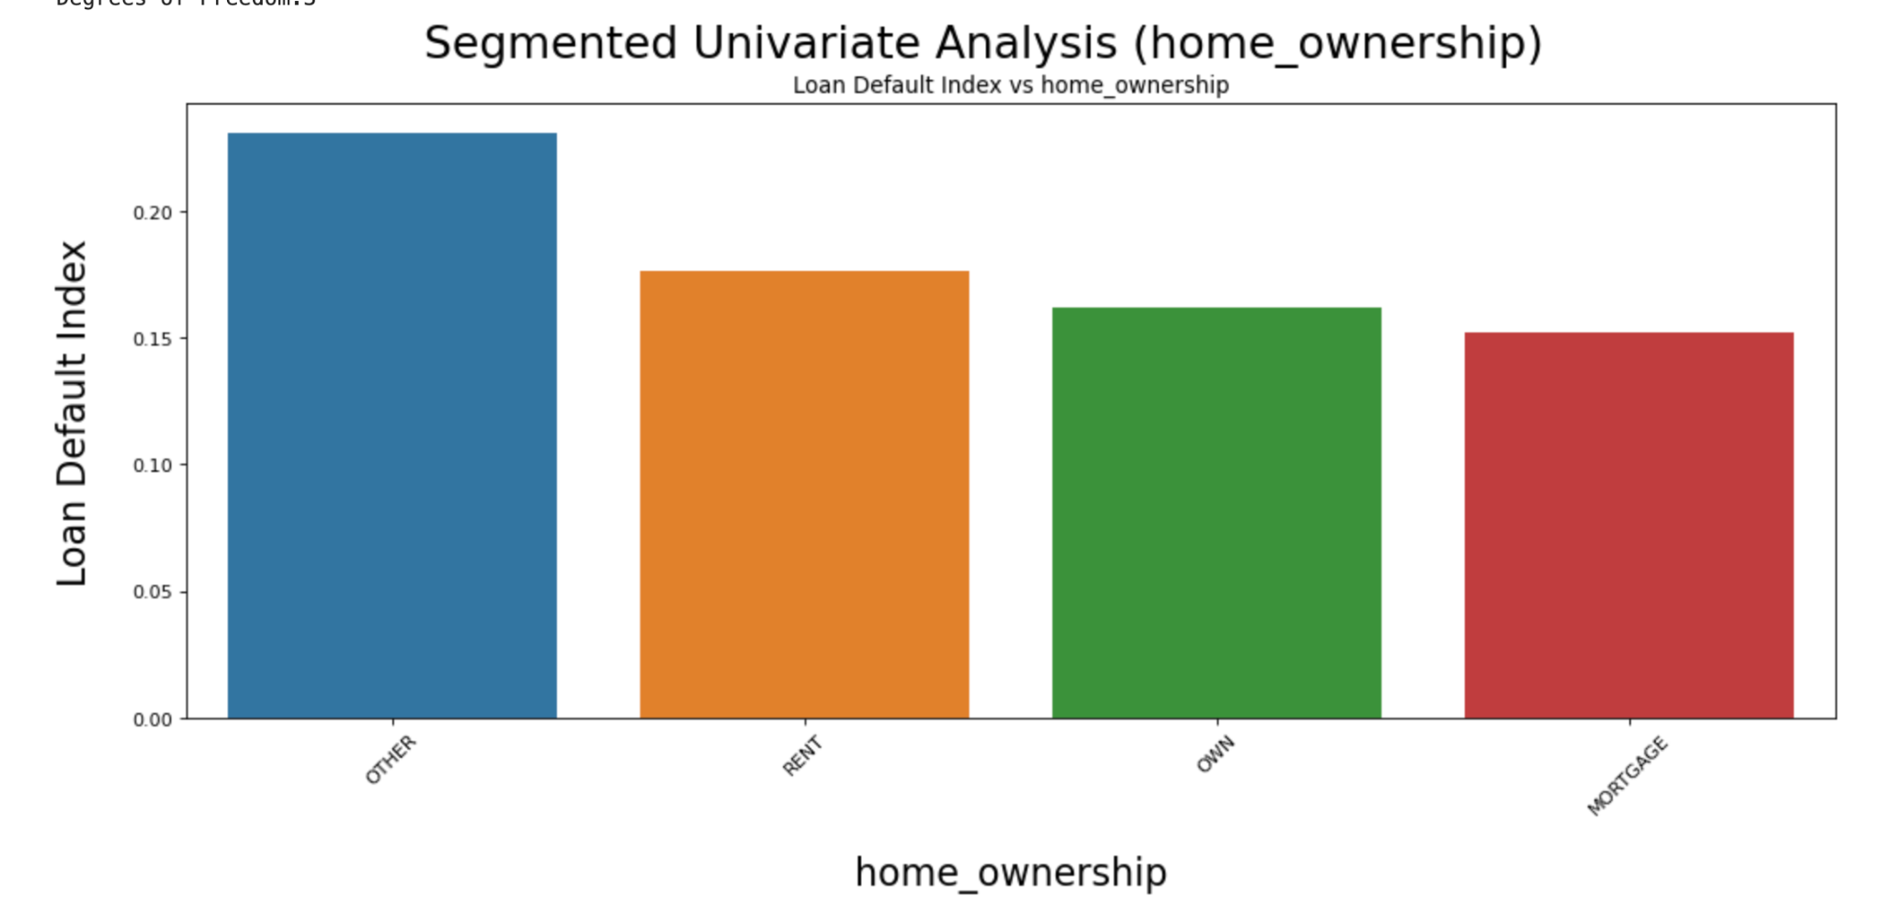
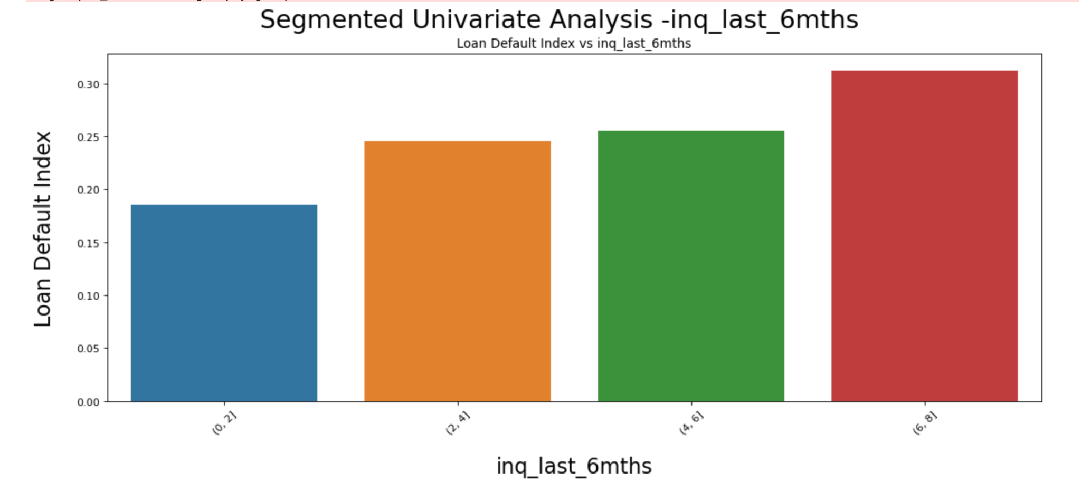
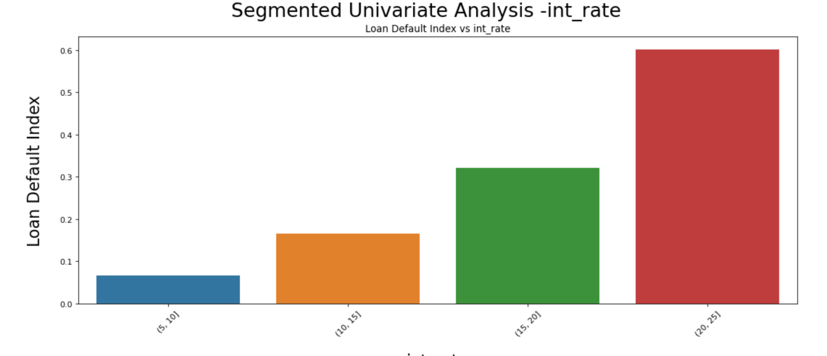
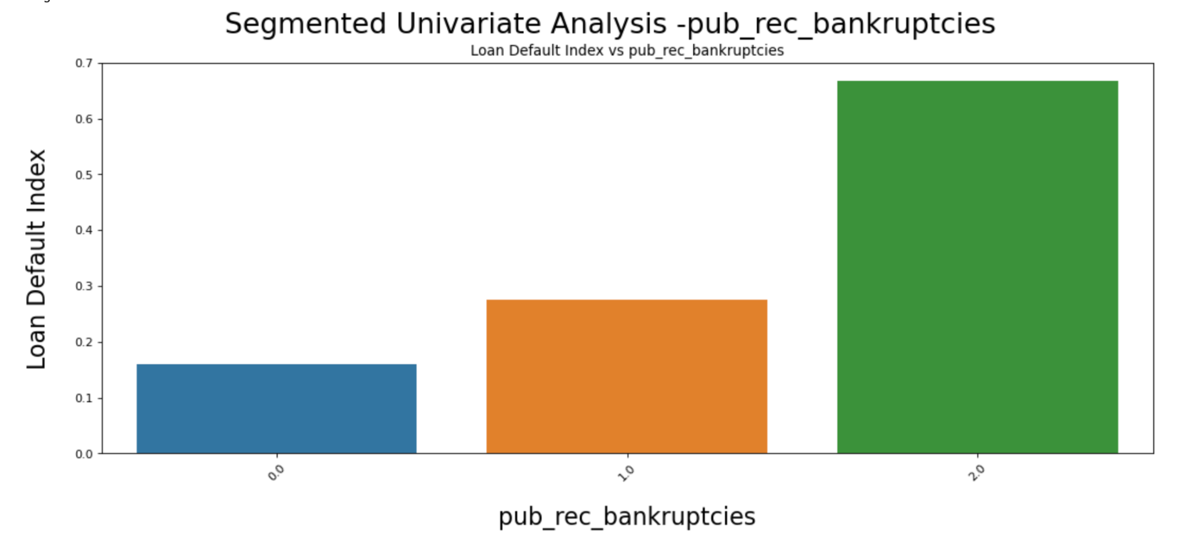

Slide 10
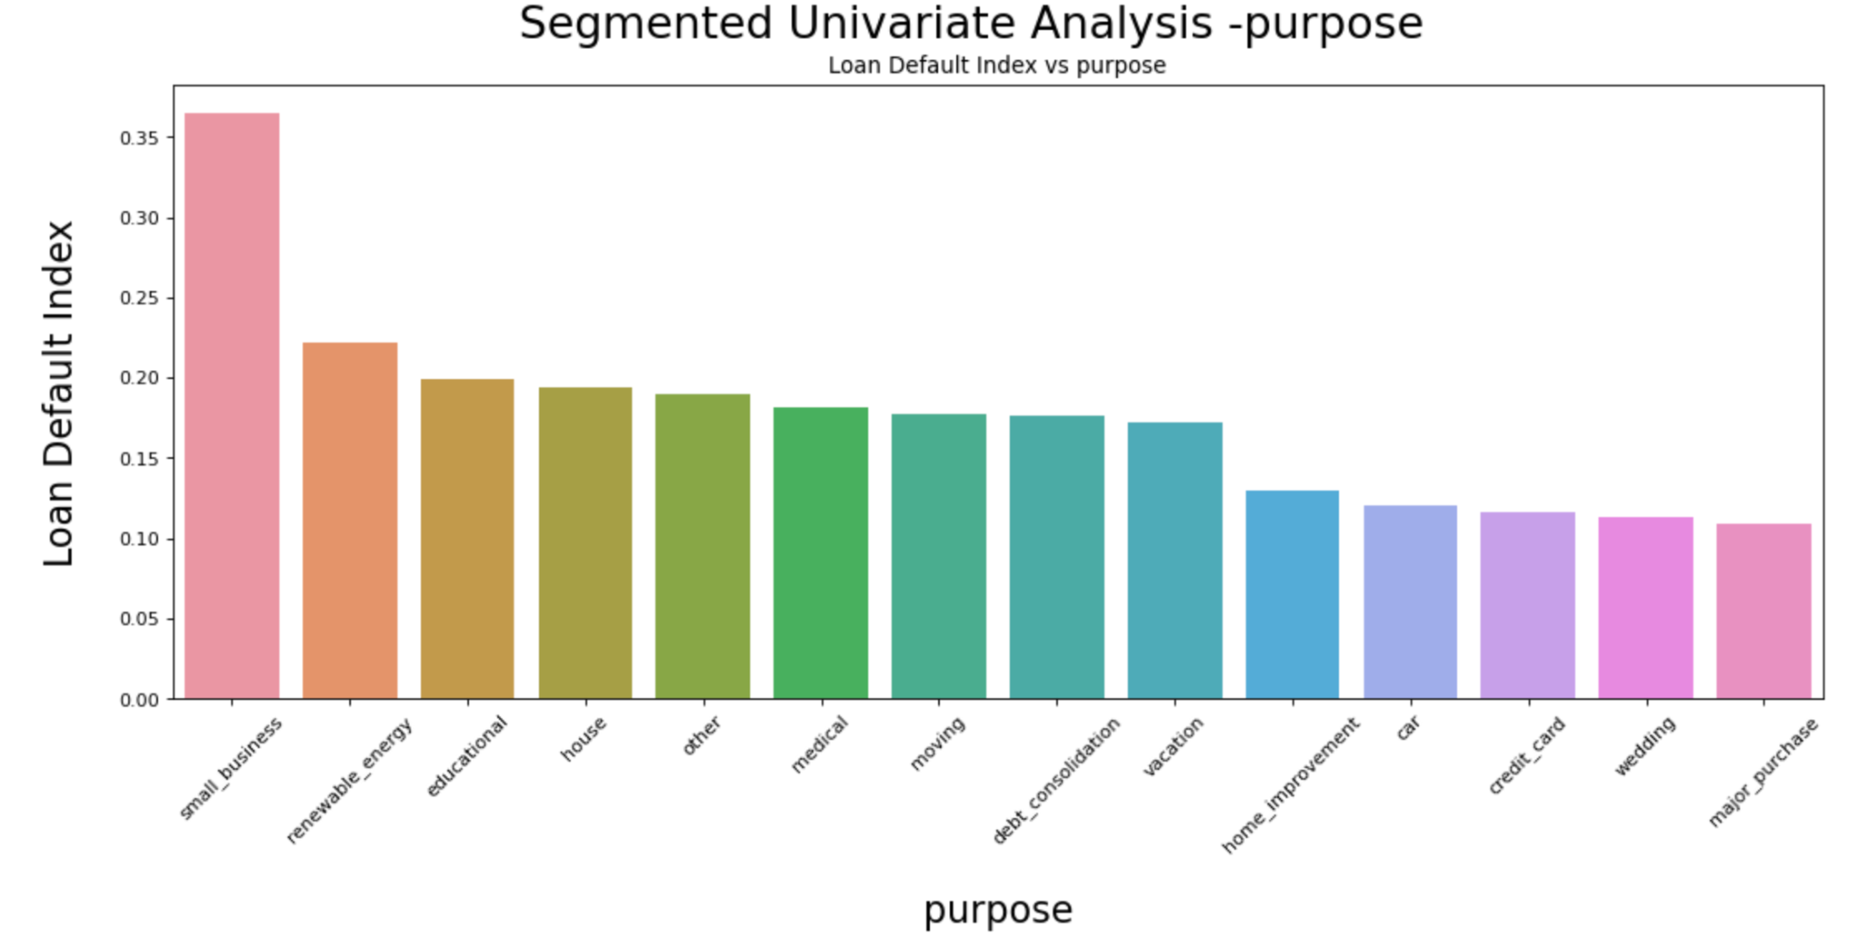

Slide 11
Segmented Univariate Analysis- Inferences
Variable | Inference
Loan purpose | The Loan default index is maximum at .35 for loan applicants borrowing to cater to the needs of small business indicating high risk lending by LC. Loans taken for personal purposes like wedding, purchase of car etc seem to have a lower index and hence less risky borrowers
Interest Rate | Loan Interest rates beyond 20% interest carries the highest default rate shown by the index value of 0.6. This is in line with the fact that higher the risk taken by LC, higher the returns.
Credit inquiries | From the data, it is observed that the default index is relatively higher at 0.3 for credit enquiries more than 6 times. Hence it is inferred that loan applicants who have a higher number of credit Inquiries are more likely to default compared to the ones that have lesser number of credit inquiries.
State of applicant | A relatively higher loan index value of 0.25 can be observed across loan applicants in the states of Nevada, Arkansas, Tennesse, South Dakota, Florida, Hawaii, New Mexico. Loan applicants from these states may have a higher probability of defaulting compared to the rest of the states in the USA
Employment length | The loan default index does not significantly vary across the length of the employment. Hence we assume that there may not be any influence on loan default by the number of years a loan applicant is employed
Grade | The risk of default seem to increase as the loan grade progresses from A to G as is evident from the default index values. Applicants assigned a loan grade of F & G have a high default index of 0.5 as against low values for A&B.

Slide 12
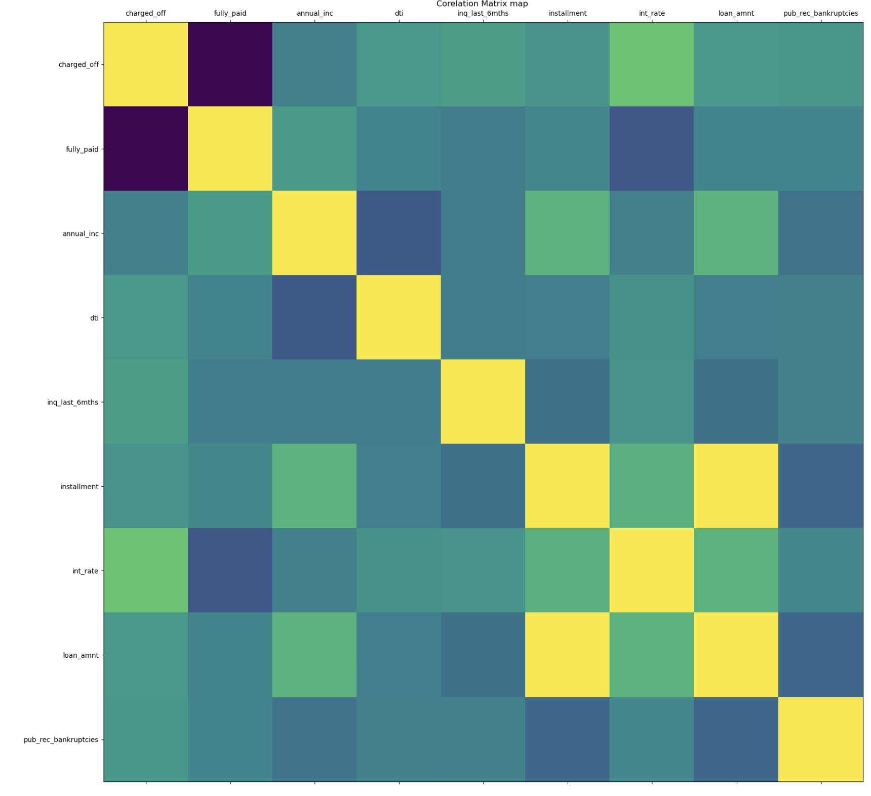
Bivariate Correlation
Attributes | Charged off trend | Fully Paid trend
Annual income | -ve | +ve
Pub_bankrupcies | +ve | -ve
Installment | +ve | -ve
Loan amount | +ve | -ve
Inq_last_6months | +ve | -ve
Interest rate | +ve | -ve

